Slide 1
DeFi Bank (Decentralized Finance)
INTRODUCTION BLOCKCHAIN AND CRYPTO CURRENCIES
2010030370 – Varshith
2010030173 – Harsha Vardhan
2010030416 – Dileep
Guided by - Dr. P Lalitha Surya Kumari

Slide 2
INTRODUCTION --
DeFi” – is an emerging open and global alternative to the restrictive, centralized and centuries-old traditional financial system much of the world knows today. DeFi offers anyone with a smartphone and an internet connection the opportunity to put their money to work on their terms across services like investing, borrowing, lending, and trading

Slide 3
LITERATURE REVIEW --
TITTLE | AUTHOR | PUBLISHED YEAR | SUMMARY
DECENTRALIZED FINANCE | Prof. Dr. Isabell Welpe, Prof. Dr. Philipp Sandner | 2022 ongoing | This paper says all about the research and backround of defi and different methodology
AI in DeFi | Nafiz Sadman, Abdur Rahman | 2022 | This paper will be saying about how can AI can be implemented in crypto and defi and intro to AI IN DEFI and blockchain
Lessons Learned from Defi | X. Meegan, T. Koens | 2017 | In this paper there will be about mistakes and how it will work in real world ,with different applications
DeFi Beyond the Hype | e Wharton Blockchain, Digital Asset Project | 2021 | It describes the basic attributes of DeFi services, the structure of the DeFi ecosystem, and emerging developments. A forthcoming Decentralized Finance Policy-Maker Toolkit will offer guidance on risks and policy approaches for governments navigating this new space

Slide 4
Work Flow
DEFI bank
Smart Contracts
Scripts
.env
Interfaces
Network connection to blockchain
python scripts
solidity codes
frontend like html
Metamask private key

Slide 5

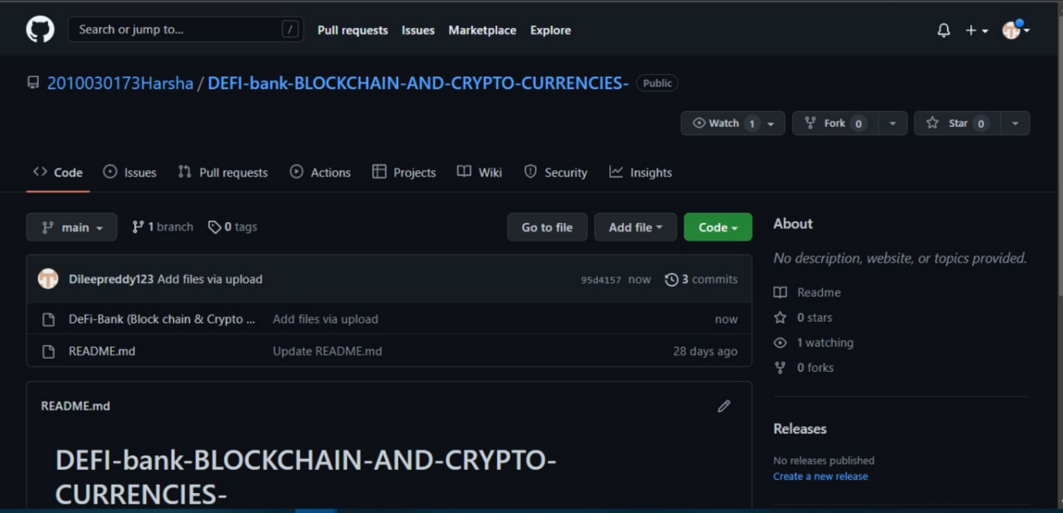
GITHUB LINK --
https://github.com/2010030173Harsha/DEFI-bank-BLOCKCHAIN-AND-CRYPTO-CURRENCIES-

Slide 6
TOOLS SETUP -
Language – solidity ,python
Ide – Remix ,vscode
Requirement – Internet

Slide 7
WORK ALLOCATION
Harsha Vardhan – working on smart contracts
Varshith – working on network to connect blockchain and keys
Dileep – using brownie and implementing different framework and metamask

Slide 8
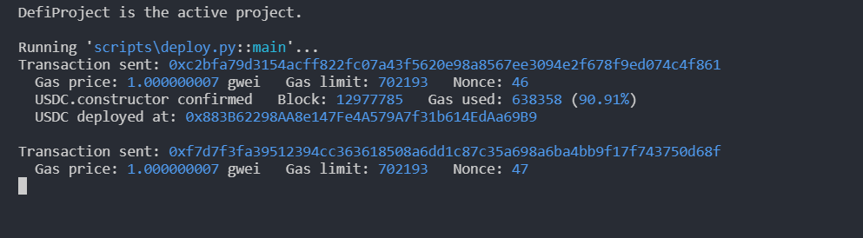
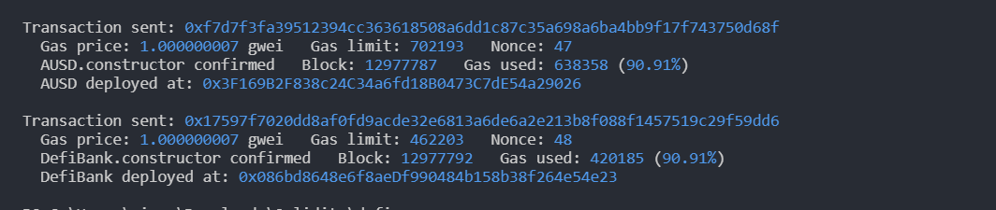
Alpha Testing

Slide 9
CONCLUSION--
The conclusion ,this is one of emerging project and very useful to people and should be used by everyone and change the things around us

Slide 10
REFERENCES --
https://www.finimize.com/wp/guides/introduction-to-decentralized-finance-defi/
https://www.ingwb.com/binaries/content/assets/insights/themes/distributed-ledger-technology/defi_white_paper_v2.0.pdf
https://wifpr.wharton.upenn.edu/wp-content/uploads/2021/05/DeFi-Beyond-the-Hype.pdf

Slide 11
THANK YOU

